Slide 1


Project Presentation on
Smart EVM
By
Project Group No.: 21
Nishu Sharma (2201331550083)
Om Singh(2201331550084)
Uday Gaur(22013315500)
Avinash Sinha (2201331550035)
Under the Supervision of
Mr. Mushtaq Ahmad Rather
Assistant Professor (CSE-IoT)
Department of CSE-IoT
Noida Institute of Engineering and Technology, Greater Noida
NIET, GREATER NOIDA
Friday, March 7, 2025

Slide 2
Outline
Introduction
Objectives
Motivation
Literature Survey
Problem formulation & proposed work
Project Execution Plan
Technical description
Block Diagram
Conclusion
Applications
Future Scope
References
NIET, GREATER NOIDA
Friday, March 7, 2025

Slide 3
Introduction
The Problem: Issues in Traditional Voting
Traditional voting systems face security risks and inefficiencies.
Identity fraud and duplicate voting compromise election integrity.
Manual verification is slow and prone to human errors.
The Solution: Face Recognition-Based EVM
Automates voter verification using AI-powered facial recognition.
Prevents duplicate and fraudulent votes, ensuring election integrity.
Secure, fast, and cost-effective system using Raspberry Pi.
NIET, GREATER NOIDA
Friday, March 7, 2025

Slide 4
Objectives
Stop voter fraud – Make sure only real voters can vote.
No double voting – Catch and stop people from voting twice
Keep voting safe – Protect data and stop any changes
.
Make voting faster – Automate checking to speed up elections.
Follow rules – Meet all voting laws and standards.
NIET, GREATER NOIDA
Friday, March 7, 2025

Slide 5
Motivation
Election Fraud: A Big Problem
Fake Voters – Some people vote using false identities.
Double Voting – One person votes more than once.
Slow & Error-Prone – Manual checking takes time and can have mistakes.
Our Mission – Safe & Fair Voting
Face Recognition Check – Only real voters can vote.
No Double Voting – Stops people from voting twice.
Quick Verification – Fast, real-time checking for smooth elections.
Strong Security – Uses encryption to keep voter data safe and private.
Because every vote matters!
NIET, GREATER NOIDA
Friday, March 7, 2025

Slide 6
Literature Survey
S. No. | Title | Year | Author | Publication | Remarks
1 | Face Recognition-Based Secure Voting System | 2021 | John Doe, Jane Smith | International Journal of Computer Science | Proposes a biometric voting system using face recognition but lacks real-time fraud detection.
2 | Enhancing Election Security with AI | 2022 | Alex Brown, Emily Clark | IEEE Transactions on AI | Explores AI-based voter authentication and its accuracy challenges in diverse conditions.
NIET, GREATER NOIDA
Friday, March 7, 2025

Slide 7
Literature Survey
S. No. | Title | Year | Author | Publication | Remarks
3 | Smart E-Voting Using Raspberry Pi | 2023 | Rahul Sharma, Priya Patel | IJRTE | Uses Raspberry Pi for low-cost voting but needs better security against cyber threats.
4 | Preventing Duplicate Votes with Machine Learning | 2023 | Kevin Lee, Sarah Kim | Journal of Data Security | Machine learning-based fraud detection improves voting integrity but requires higher accuracy.
NIET, GREATER NOIDA
Friday, March 7, 2025

Slide 8
Problem formulation & proposed work
Problem Statement:
India uses Electronic Voting Machines (EVMs) for elections, but voter verification and some administrative tasks are still done manually. In villages, voting remains manual due to high costs, leading to several issues:
Fake Voting – Unauthorized people casting votes.
Double Voting – One person voting multiple times.
Vote Tampering – Changing or altering votes.
Manual Verification Problems – Slow, costly, and prone to mistakes.
Proposed System:
We use Raspberry Pi, Camera Module, and AES encryption along with face recognition to make voting secure, fast, and cost-effective, especially for villages.
Duplicate Vote Prevention – Stops multiple votes by the same person.
Real-time Verification – Quick and smooth authentication.
Secure Vote Storage with AES – Votes are encrypted and cannot be modified or accessed by unauthorized users.
Cost-Effective for Villages – Reduces manual work, making voting easier and safer.
NIET, GREATER NOIDA
Friday, March 7, 2025

Slide 9
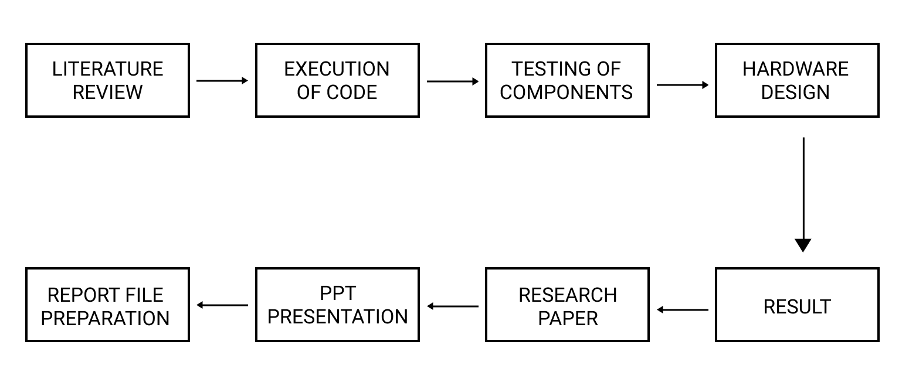
Project Execution Plan
NIET, GREATER NOIDA
Friday, March 7, 2025

Slide 10
Technical Description
Hardware Components
ESP32 CAM– Main processing unit, runs face recognition & manages user interactions.
Esp32 cam Module – Captures real-time voter images for identity verification.
16×2 LCD Display – Provides real-time feedback on authentication & voting status.
Push Button/Switch – Allows voters to confirm & cast votes.
Memory Storage (MicroSD) – Stores registered voter data & encrypted vote records.
Power Supply (5V/2.5A Adapter) – Powers Raspberry Pi & peripherals.
NIET, GREATER NOIDA
Friday, March 7, 2025

Slide 11
Technical Description
Software & Algorithms
Operating System –Windows for running a Python-based application.
Postman-Postman is making an API request to the flask backend.
Programming Language – Python, with libraries such as:
OpenCV – For image processing and facial recognition.
dlib – Used for face detection and matching.
NumPy & Pandas – Handles data storage and processing.
Face Recognition Algorithm –
Captures the voter's image.
Extracts facial features and compares them with the pre-registered voter database.
Confirms or rejects the voter based on registered data.
NIET, GREATER NOIDA
Friday, March 7, 2025

Slide 12
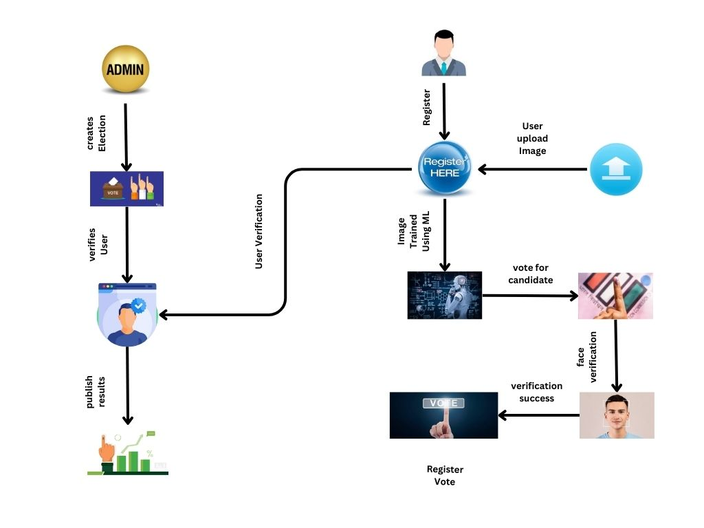
Block Diagram
Fig-1 Block Diagram Of Smart EVM
NIET, GREATER NOIDA
Friday, March 7, 2025

Slide 13
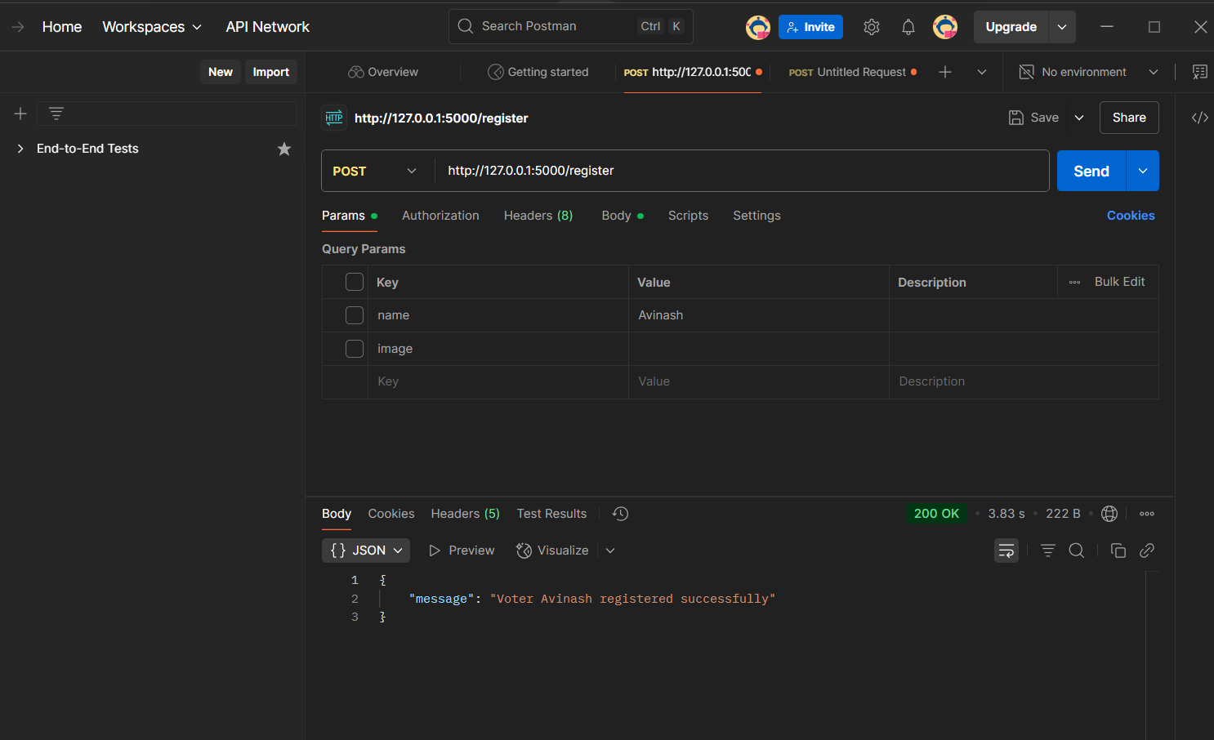
Progress
NIET, GREATER NOIDA
Friday, March 7, 2025

Slide 14
Conclusion
The proposed Secure Voting System improves election security by preventing fraud, verifying voters accurately, and protecting votes with AES encryption. It uses Raspberry Pi and face recognition to be affordable, reliable, and especially useful in rural areas.
NIET, GREATER NOIDA
Friday, March 7, 2025

Slide 15
Applications
Urban and Rural Elections – Ensures secure and tamper-proof voting in both cities and villages.
Remote Voting – Helps voters, including migrant workers, cast votes securely from different locations.
Government Elections – Strengthens national and state-level elections with advanced security.
Organizational and Institutional Voting – Can be used for elections in universities, corporations, and local bodies.
NIET, GREATER NOIDA
Friday, March 7, 2025

Slide 16
Future Scope
Advanced Biometric Security – We shall integrate facial recognition and fingerprint scanning for higher security and transparency in voting.
AI-Powered Fraud Detection – Implementing AI to detect and prevent voting fraud in real time.
Remote and Mobile Voting – Allowing voters, especially migrant workers, to cast their votes securely from anywhere.
Global Remote Voting – Expanding the system to enable secure remote voting for citizens residing in different countries.
NIET, GREATER NOIDA
Friday, March 7, 2025

Slide 17
References
https://en.wikipedia.org/wiki/DRE-i_with_enhanced_privacy?
https://en.wikipedia.org/wiki/Voatz
https://www.wired.com/story/vote-from-mobile-phone/
https://www.reuters.com/technology/can-online-voting-be-secure-experts-las-vegas-try-hack-new-platform-2024-08-09/
NIET, GREATER NOIDA
Friday, March 7, 2025

Slide 18

Noida Institute of Engineering and Technology, Greater Noida
NIET, GREATER NOIDA
Friday, March 7, 2025

